Slide 1

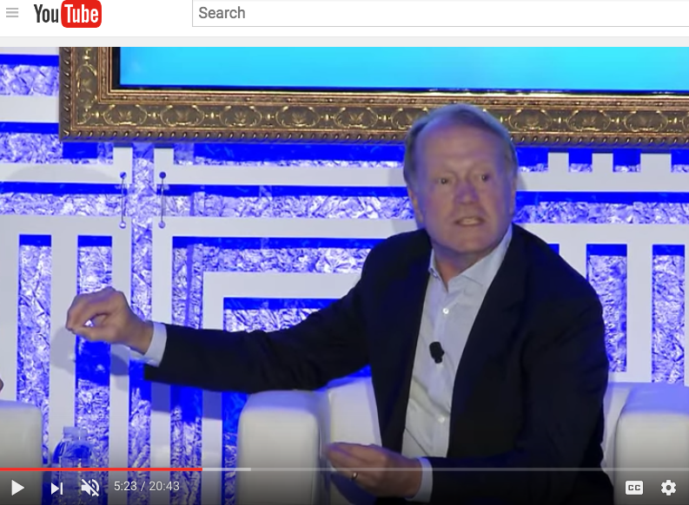
Internal Press Release
“Iterating on a press release is a lot less expensive than iterating on the product itself (and quicker!),” Ian McAllister - Amazon
John Chambers – Cisco

Slide 2
Internal Press Release - Template
Heading – Name the product in a way the reader (i.e. your target customers) will understand.
Sub-Heading – Describe who the market for the product is and what benefit they get. One sentence only underneath the title.
Summary – Give a summary of the product and the benefit. Assume the reader will not read anything else so make this paragraph good.
Problem – Describe the problem your product solves.
Solution – Describe how your product elegantly solves the problem.
Quote from You – A quote from a spokesperson in your company.
How to Get Started – Describe how easy it is to get started.
Customer Quote – Provide a quote from a hypothetical customer that describes how they experienced the benefit.
Closing and Call to Action – Wrap it up and give pointers where the reader should go next.

